Slide 1
Object Oriented Programming
in Python

Slide 2
Python Supports All Different Programming Paradigms
Functional Programming (if you can achieve a certain task without changing the data, we still accomplish the task, ex-lambdas)
Procedure Oriented Programming(break down the project into small small modules will be functions)
Object Oriented Programming

Slide 3
Polymorphism
Object
Class
Encapsulation
Abstraction

Slide 4
We use objects in real world. We solve real world issues with help of virtual world solution
Every objects will have ATTRIBUTES and BEHAVIOURS
Method-functions in OOPs are called as methods
Python uses objects and classes together

Slide 5
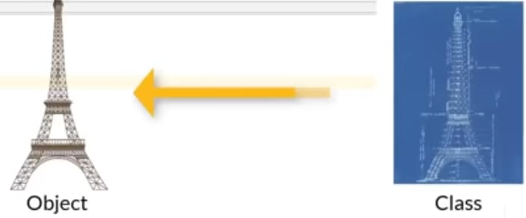
Classes means it has been designed only once.
Ex-a phone has been manufactured multiple times but it can be designed only once. This design in OOPs is called class
Class-is a design or a blueprint for an object
Object-instance of a class

Slide 6
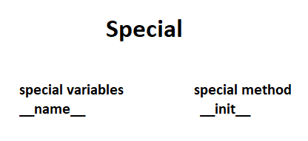

Slide 7
